Slide 1
Chapter 9 Representation of Numbers
By
Hyung Jae (Chris) Chang
Troy University

Slide 2

Base-N and Binary
Decimal system
base 10: based on 10 digits (0 ~ 9)
Each digit represents the coefficient for a power of 10.
Binary numbers
base 2: based on 2 digits (0 and 1)
Each digit represents the coefficient of a power of 2.
Digits in a binary number are known as bits.
Binary numbers used in computer systems.
32-bit computer: can represent and compute 32-digit binary numbers.

Slide 3
Floating Point Numbers
To represent/store floating point numbers, we allocate usable bits to three different parts.
Sign indicator s: used to indicate whether a number if positive or negative
Characteristic or exponent e: used to indicate the power of 2
Fraction f: used to indicate the coefficient of the exponent.
Almost all platforms map Python floats to the IEEE754 double precision for a total of 64 usable bits.
Significand: Bit to the left of the binary point and fractional part of the
Binary number.
1.0101 x 2⁻³
Exponent: Exponent follows the complement
Signed number representation.
Fraction: Bits to the right of the binary point.

Slide 4
Floating Point Numbers (cont.)
IEEE754 Floating Point Representation
S: sign bit (0 → non-negative, 1 → negative)
Normalize significand: 1.0 ≤ |significand| < 2.0
Always has a leading pre-binary-point 1 bit, so no need to represent it explicitly (hidden bit)
Significand is Fraction with the “1.” restored
Exponent: excess representation: actual exponent + Bias
Ensures exponent is unsigned
Single: Bias = 127; Double: Bias = 1023
Single: 8 bits
Double: 11 bits
Single: 23 bits
Double: 52 bits
S
Exponent
Fraction
X = (-1)^{s} X (1 + Fraction) X 2^{(Actual Exponent)}

Slide 5
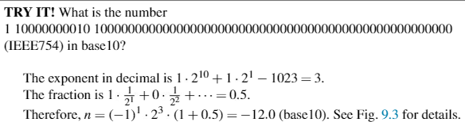

Examples
IEEE754 Floating Point Representation

Slide 6
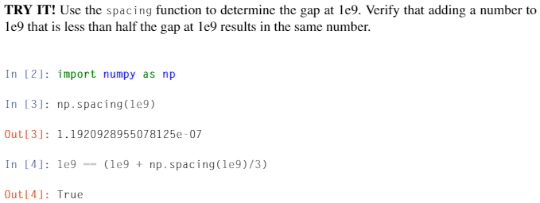
Gap between Two Immediate Numbers
We call the distance from one number to the next one the “gap”.
Since the fraction is multiplied by 2^{e-1023}, the gap grows as the number represented grows.

Slide 7
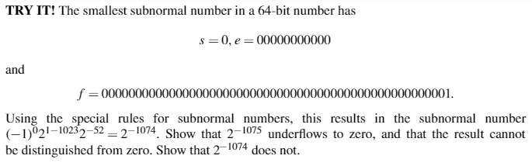
Overflow and Underflow
Overflow: happens when numbers that are larger that the largest floating point number capable of being represented.
Underflow: happens when numbers that are smaller than the smallest subnormal number where subnormal numbers have the exponent 0; the implicit leading bit is 0 (but not 1) when all exponent bits are zero in IEEE754.

Slide 8
Round-Off Errors
Using IEEE754, there is a drawback that we can’t store a floating point number with a perfect precision; instead, the numbers are approximated by a finite number of bytes.
Round-off error
The difference between an approximation of a number used in computation and its correct/true value
Very common error found in numerical calculations.
Truncation error
Another common error found in numerical calculations.
Will be introduced in later chapter.

Slide 9
Round-Off Errors (cont.)
The most common form of a round-off error is the representation error in the floating point numbers.
Example
Pi in math
1/3
Multiple number of errors will cause the errors accumulated.
Floating point Arithmetic
Let’s try this in Python: “4.9 – 4.845 == 0.055”
What do you see?
The result of subtraction is 0.055000000000000604 in Python since the floating point can’t be represented by the exact number, but by an approximation.
Examples
4.49 – 4.845 = 0.055000000000000604
4.8 – 4.845 = - 0.04499999999999993

Slide 10
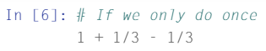
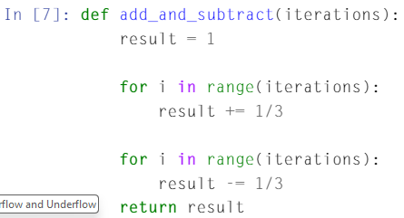
Accumulation of Round-Off Errors
As we do a sequence of calculations, the round-off errors are magnified/accumulated.
Example

